Slide 1
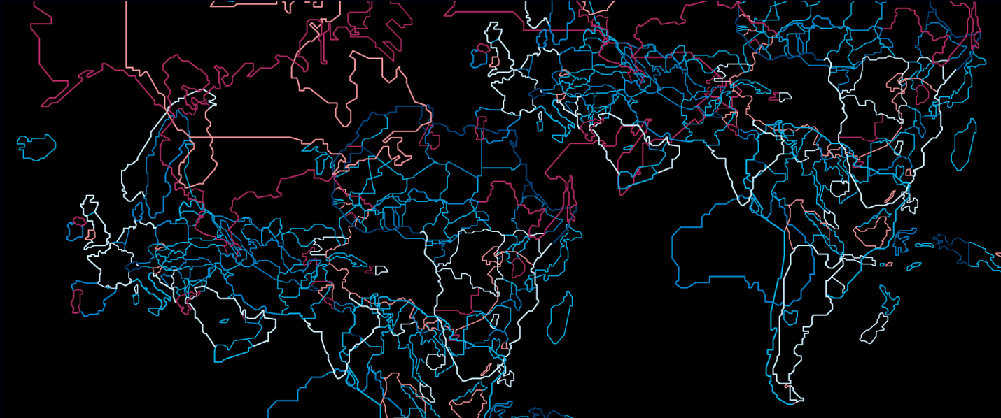

Efficient OCL Impact Analysis
Thomas Goldschmidt, ABB Corporate Research
Axel Uhl, SAP AG Made available under EPL 1.0

Slide 2
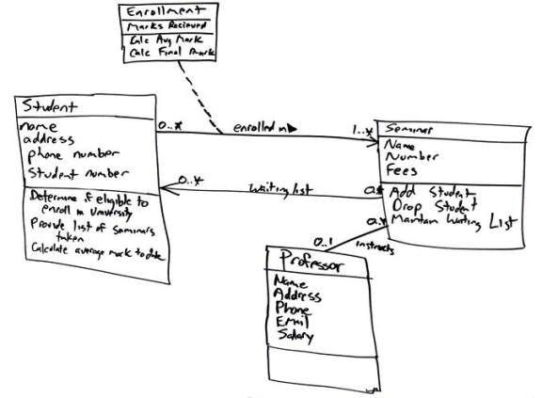
Motivation
The Object Constraint Language (OCL) is used for different purposes in modelling:
Constraints
Queries
Model Transformation
Especially when used in model transformations OCL expressions form a kind of implicit dependency
OCL query:
elements→select(e | e.isRelevant)
source scope
result

Slide 3

Motivation (2)
What happens if the source model changes?
Result may be invalidated.
OCL expressions needs to be re-evaluated.
But what happens if things grow large?
Huge models.
Many, complex constraints.
Re-evaluating all constraints becomes infeasible.
Naive approach:
O(|expressions| * |modelElements|)

Slide 4
More Generally
Given …
a set of OCL expressions
a set of model elements
a model change notification
Which of the OCL expressions may have changed its value on which context elements?

Slide 5
Agenda
Running example
The traceback function
Partial evaluation and delta propagation
Changes in unused subexpressions
Evaluation
x

Slide 6
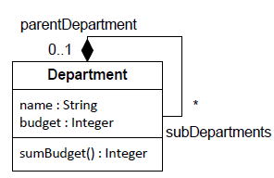
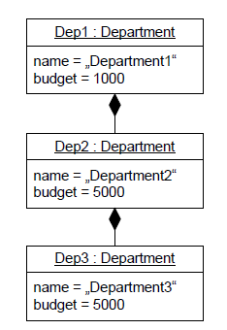


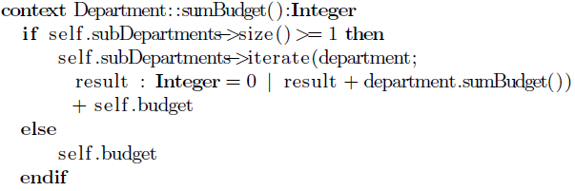

Running Example
Metamodel
Example Model

Slide 7
The traceback function
Goal: Compute all context objects „self“, that for which a given expression e evaluates to a different result than before the change.
Example:
Expression: self.subDepartments.budget
Change: c₁ = (dep2.budget from 5000 to 5001)
traceback : Given a model change determine all expressions which navigate to that property.
traceback_{self.subDepartments.budget}(dep2) = {dep1}

Slide 8
The traceback function (2)
Defined for each type of OCL expression.
For example: PropertyCallExp (simplified):
traceback_{n}(s) := let t’ =
`n.source.type` . allInstances()->select(
`n.referredProperty` = s)->select(x |
x.oclIsKindOf( `n.source.type`) ) in
sourceObjects->collect(so | traceback_{n.source}(so; t’)))
Example: self.subDepartments.budget
PropertyCall
source
referredProperty
PropertyCall
Budget : Property
source
referredProperty
SelfExp
subDepartments : Property

Slide 9

Delta Propagation
In some cases changes cannot have caused an expression to change its result.
Example: self.subDepartments->select(d | d.x)
Where x is of type Boolean
Adding an element to reference b which has x set to false will not change the result of the expression.
For complex expressions early determination of empty change sets could reduce computation effort.
δ

Slide 10

Delta Propagation (2)
An expression e is monotonic iff:
It is a CallExp expression with upper multiplicity > 1
It‘s source expression s has an upper multiplicity > 1
Adding an element to s‘s result either
Leaves e‘s result collection unchanged or
Adds one or more elements to e‘s result
For each monotonic expression (such as select, collect, if-then-else, etc.) we define a function δ_{e} which indicates the change in the e‘s set of elements.
Recursively applied this allows for early determination of changes that do not affect the result of an expression.

Slide 11

Partial Evaluation
For some expressions a „look to the right“ during change analysis can also avoid unnecessary computations:
Example: self.name = ‚abc‘
Not affected by a name change from ‚x‘ to ‚y‘
Combination of Delta Propagation and Partial Evaluation:
Use partial evaluation to determine old and new values of call expressions
If delta propagates to an empty set using delta propagation the expression isn‘t affected by the change.

Slide 12
Changes in Unused Subexpressions
If subexpressions are not used to determine the result of the overall expressions changes to them do not impact the overall result.
Example:
context Department inv: if self.name = ‘Boss’ then self.budget < 20 000 else self.sumBudget() < 10 000 endif
If a department‘s name is „Boss“, a change to the subDepartments property will not affect the result of the constraint

Slide 13
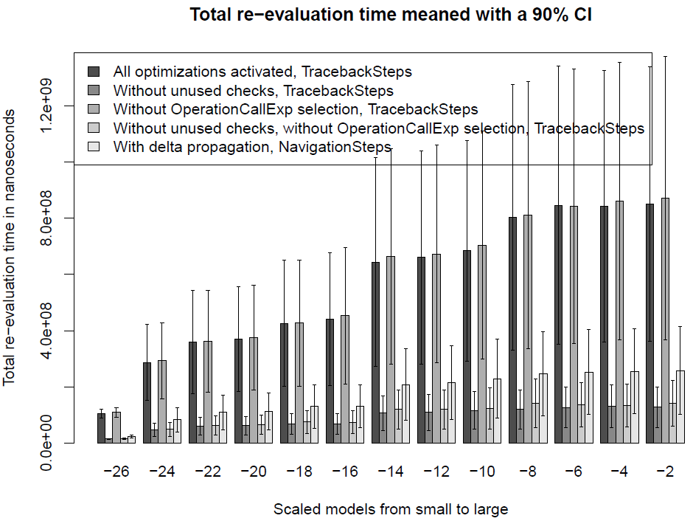
Evaluation

Slide 14
Evaluation (2)
Results at a glance:
Traceback implementation significantly faster than naive approach.
Partial Evaluation and Delta Propagation have a great positive impact on performance.
Unused Subexpressions Check requires a lot of additional partial evaluations which do not amortise

Slide 15

Application Scenario
FURCAS language workbench (www.furcas.org) [1]
OCL-based attribute grammar
OCL used for queries and attribute computation
Changes in one part of the model need to be propagated to dependent parts using Impact Analysis
Other features of FURCAS:
View-based modelling for textual languages
Decorator model for textual views allows for separation of model content and textual representation

Slide 16
Conclusions & Future Work
OCL Impact Analysis allows to efficiently re-evaluate OCL expressions over larger models.
Optimisations additionally positively influence IA performance.
Impact Analysis implementation available at:
Indigo Update Site:
Modeling – OCL Examples and Editors
Then see bundle org.eclipse.ocl.examples.impactanalyzer
Future Work
Promote from examples/ to plugins/ after Eclipse Indigo
Extract OCL attribute grammar component from FURCAS

Slide 17
References
[1] Thomas Goldschmidt. View-Based Textual Modelling. PhD thesis, Karlsruhe Institute of Technology, 2010. to appear

